Slide 1


Slide 2
Mission, Vision and Goals
Mission: To Provide a convenient service of food delivery.
Vision: To promote and contribute to an ease of living
Goals: Aid in helping those who need the convenience of a food delivery service.

Slide 3
Problems
Food Delivery is only offered by large and established restaurant chains.
People having a tight schedule would avoid travel.
Entire population does not have access to vehicles

Slide 4
Solution
FoodPort: iPhone/Android app and website.
“We provide 24x7 delivery service for food companies and restaurants that don’t already have their own and option for users to sell their own home cooked food”
Use cars to transport food and phones/computers for taking orders

Slide 5
Get your Food, wherever you are, whenever you want !!
Consumer
Choose (Resto or Chef)
Order
Eat
Cook
Update
Sale
Chef

Slide 6
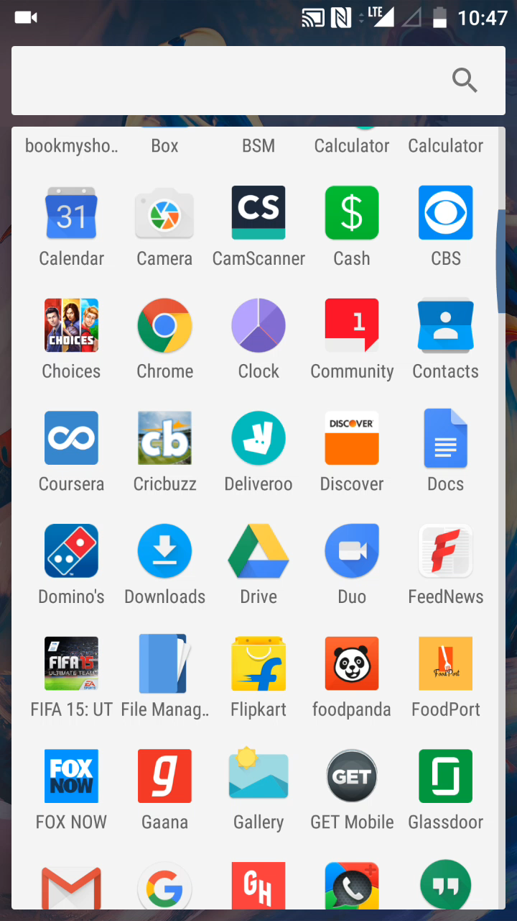

Slide 7
Target Market
Primary target are people who do not possess any medium of transportation
Chefs/people who likes to cook but cannot afford to invest lot of money building actual restaurant
Students and working professionals who have tight schedule and prefer to not travel for food.
Elderly and disables citizens who have trouble cooking

Slide 8
Market Validation

Slide 9
Takeout and Delivery Market

Slide 10
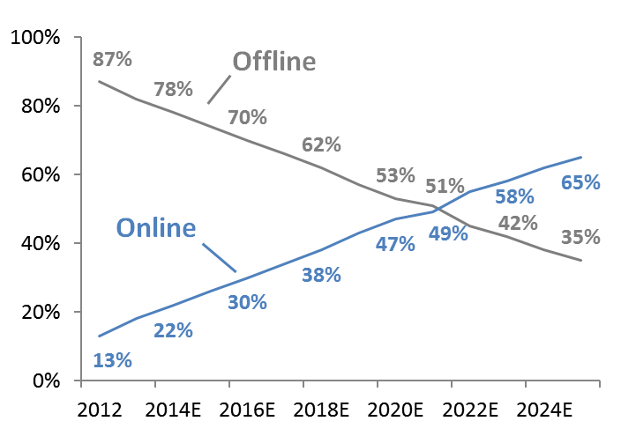
Online vs Offline Ordering in near future

Slide 11
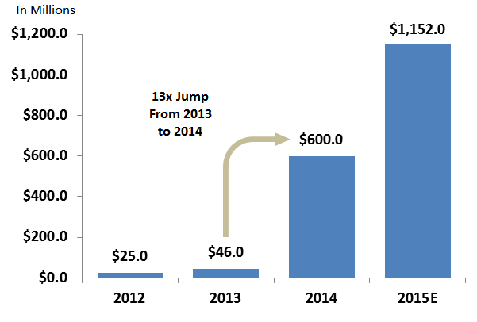
Capital Inflows to Food Ordering Space

Slide 12
Market is competitive but not saturated !!!
Notes:
https://techcrunch.com/2015/05/07/a-secular-shift-to-online-food-ordering/#.bwz6pb:OA8a

Slide 13
Industry Analysis and Our Strategy

Slide 14
Three steps to On demand Food
Order
Cook
Deliver
Three dimensions in Operations
Software(Order) Only
Software(Order) and Logistics(Delivery)
Software, Delivery and Cooking

Slide 15
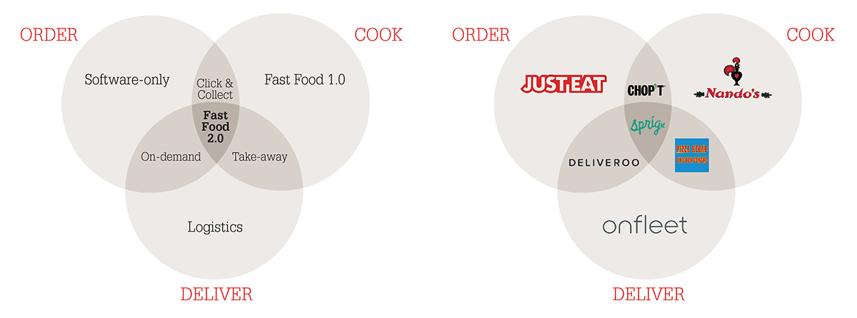
Market Space

Slide 16
1. Software only space
The software-only marketplaces’ main selling point to restaurants is to bring a lot of new orders and replace their antiquated phone-ordering system with an optimized Web and mobile platform, that integrates with their kitchen workflow.
Don’t touch the food itself (neither cooking, nor delivering it), these platforms tend to charge a lowish fee of 10-15%.
As any pure software business, they’re highly scalable and have all experienced remarkable growth.
JustEat, Grubhub, Delivery Hero

Slide 17
Software Only - Shortcomings
Reliance on the restaurants’ own couriers mean that they are somewhat limited in their offering of cuisines and price points
They cannot control and optimize the speed and quality of the delivery.

Slide 18
2. Software and delivery
focus on step 1 and 3 of the process: they bring extra traffic and orders to the restaurants, but also manage the delivery for them, through their fleet of independent couriers connected by an Uber-like mobile app.
benefit from stronger barriers to entry and scale advantage: it will be very hard for a new entrant to compete against these optimized networks of restaurants and couriers, once they will have reached maturity in a city.
They also charge higher commission, 25-30% on average.
Their killer feature is that they can offer a range of restaurants and price points that software-only marketplaces cannot.
Doordash, Deliveroo, Caviar

Slide 19
Software and delivery : Shortcomings
They are both software and logistics companies and have a very significant amount of operational work to do (couriers’ hiring and training, equipment maintenance, shift planning, etc.).
These on-demand marketplaces are therefore not as easy to scale as the pure-software one

Slide 20
3. Fast Food 2.0 (Software, Cooking and Delivery)
Sprig, Maple and Spoonrocket
full integration of the process: they developed their own app through which consumers can order a limited range of meals, reheated in their own fleet of cars as orders come in, and delivered in 15 minutes (as they save on the kitchen preparation time).
They trade choice for convenience and a highly curated experience.

Slide 21
Fast Food 2.0 : Shortcomings
building and running their own nationwide delivery infrastructure would require enormous investments, and pose great challenges as competition for couriers heats up, and will instead turn to third-party providers.

Slide 22
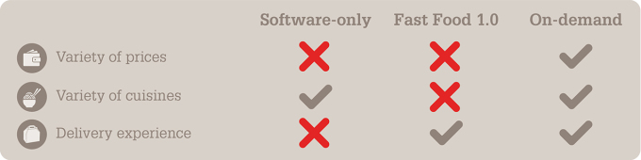
Industry Trend :
the on-demand marketplaces offer the best overall value for customers’ money due to the wider range of food options, through a reliable delivery experience, at no additional costs vs. in-restaurant.

Slide 23
Industry Trends : Continued ..
Here are three predictions for how the food delivery sector could evolve in the future:
Software-only marketplaces (a la Just-Eat) will try to bring delivery in-house, while on-demand restaurants (a la Maple) will outsource it.
On-demand marketplaces will unleash a wave of new “virtual” restaurant chains
Drones will supercharge this shift and the competitive advantage of on-demand marketplaces

Slide 24
That’s why we choose to operate in Software and Delivery network i.e. On Demand Food Delivery

Slide 25
Roadmap:
Start with UB Students(Pilot Phase)
Expand Operating area to Buffalo
Expand Beyond Buffalo

Slide 26
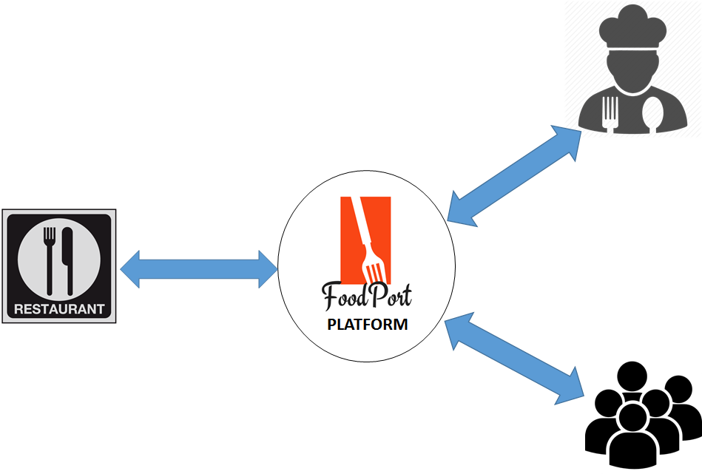
Business Model
Notes:
Income will be generated by charging both the customer and the hotel franchise on per order basis.
A certain percentage of each order’s price is pre decided as the charge for the services provided by FoodPort.
80% of this charge is paid by the hotel franchise and rest by the customer.

Slide 27
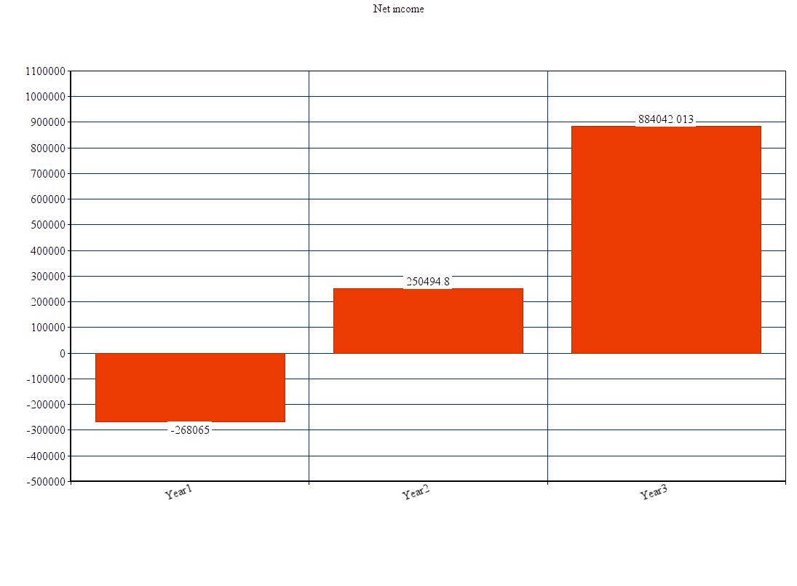

Slide 28
Funding
Where do we get the funds from?
Initial investments are by us 4 co-founders, we each have pledged $10,000 into the venture.
$25,000 is accumulated with generous support from family and friends.
$75,000 is planned to be raised in seed funding or angel investments.
This gives us a working capital for year 2017. By end of which we’ll implemented the product and a pilot phase been completed to lead us with data in further funding rounds.

Slide 29
Customer Acquisition & Retention
Campus promotion events (pilot phase)
Flyers, stickers and pamphlets throughout campus and popular residences amongst students living on-and-off campus.
Digital Marketing (immediately after product launch)
SEO
Coupons and discounts (in works).
Promotion through partnering vendors.

Slide 30
Exit Strategy
Go BIG ! Go PUBLIC ! Launch an IPO..
Being acquired by a larger company..
Selling the business to known people or an interested party.

